Slide 1


Department of Computer Science and Engineering
“Restaurant Automation”
RAJAT SURANA (17BTRCS053)
TANISHQ DALAL (17BTRCS055)
KAUSTUV GIRI (17BTRCS070)
Under the guidance of
Dr/Prof: KESHAVMURTY

Slide 2
Contents
Objective
Problem Definition
Existing System
Limitations of Existing Systems
Proposed System
Modules
UML Diagrams
Use Case Diagram.
Class Diagram.
Sequence Diagram
Collaboration Diagram
State Diagram
Component Diagram
Deployment Diagram
Conclusion and Future Work

Slide 3
Objective
The goal for this project is to introduce automation in privately-owned restaurants, that is, small- to medium-sized establishments. Typical problems restaurant personnel are facing include: • Coordination of their work activities • Anticipating and handling periods of low/high patron traffic
• Recognizing trends early enough to take advantage of bestsellers or abandon the flops • Lowering operating costs, and increasing efficiency/productivity and profits Many restaurants are still operated using pen and paper methods, with little or no automation (see Figure 1). Patrons enter the facility to be greeted by a host, who often times has a “dry erase” diagram of the tables, maintained on a blackboard. The host can see the status of the tables based on whether or not they or someone else physically updates the diagram. Once seated a waiter tends to the costumers by jotting down the orders onto a piece of carbon paper and delivers it to the kitchen for proper food preparation. The waiter then has to periodically check back to find out when the meal is ready. When the food is done, the piece of carbon paper is saved for proper record keeping by the management. This “old fashion” system works but yields a large amount of tab receipts, wastes a lot of time and is simply out-of-date. In old fashion systems, waiters have to carry pads around to take orders, always have a working pen and be sure to keep each bill organized and “synchronized” with the proper table.

Slide 4
Another issue is record maintenance. In the old system, when everything is done by paper, the management is responsible to keep all information saved and organized, which is no easy task. Everyday tabs are collected, data needs to be organized and employees need to get paid. This requires a great deal of time and attention from the managers. This project computerizes restaurant operation so that all information pertaining to patron’s orders and staff activity will be conveniently shared and stored over the restaurant’s intranet. Hosts will be able to view table status with a click of a button. The wait staff will be able to enter the patron’s orders quickly and efficiently and then have it electronically delivered to the kitchen. The kitchen staff will be able to view the incoming orders and notify the proper wait staff when the food is ready. Bus boys will be able to view real-time floor status allowing them to know which tables are clean, dirty, or occupied. Most importantly, all of the restaurant information is organized and saved in the system database for the management viewing and archival.
The analysis will consist of by-the-day and by-the-hour breakdowns of: • Revenue and revenue percentage per menu item • Menu item popularity
Jules recently graduated in engineering. To celebrate his first salary, he took his high-school buddy Jim to a family-owned establishment…
JulesJim JulesJim
Software Engineering Course Project • Restaurant Automation 3

Slide 5
• Personnel efficiency • Average turnaround time (how long patrons spend in the restaurant) • Average preparation time (time from when the order is placed to when it is ready) There is no more abundance of papers and long hours of punching numbers. All data is automatically collected and processed allowing management to focus on analyzing the data rather than calculating it.

Slide 6
Problem Definition
Chef: Working in a kitchen can be strenuous(energetic) and it can be difficult to keep track of everything that needs to be done. Orders need to be filled in a reasonable amount of time while simultaneously ensuring that any dish accommodations are accounted for. This needs to be done with accuracy or else an order could be made incorrectly or even worse, a person with a food allergy could get hurt as a result of a waiter’s poor handwriting. We want to get our orders out with accuracy and speed to make sure we have a happy returning customer. When dishes are complete and the waiter does not pick it up for a few minutes, it is a pain because the food gets colder and it takes up space on the counter that could be used otherwise. Also, at the end of a busy day of serving hundreds of customers the inventory can be depleted to the point of needing restocking and it’s difficult to keep track of what’s expired and what chef need more of. Chef have so many responsibilities that it can be difficult to keep track of everything in the pantry. Chef have to make sure that the expired ingredients are cycled out and that the low stock ingredients are replenished in time for the upcoming week. It would be helpful to have a tool that would track the expiration dates of food to make sure everything is fresh.
It would be a great help if chef had something that clearly displays all incoming orders and the modifications that have been requested by the customers. Also, if multiple dishes come in with the same ingredients, it will be helpful if the chef was notified to make more of a certain ingredient at one time versus cooking a certain part of a dish twice. This can save more time in the kitchen and make the cooking process more efficient. Finally, a way to signal to the waitresses and waiters that the order is finished and ready to be taken to the table to reduce the time the food sits on the counter.

Slide 7
Host/Hostess: Whenever while welcoming customers into restaurant,they aim to make the start of their experience as flawless as possible. As parties of multiple people arrive, they tend to have different requests and requirements based on how many people they have and where they want to sit. Sometimes can have a party of 8 looking for a round table in a corner, where as other times can get a family of 4 wanting a booth.Host/Hostess love to find them their preferred seating, but sometimes there just isn’t an available spot, and host/hostess aren’t really sure how long it will be for an appropriate spot to open up.
Finding an exceptional table for guests can sometimes be a challenge, especially when host/hostess unsure of which tables are ready to go. When host/hostess welcoming customers in, it would be great if there was a way to easily keep track of which tables are currently cleaned and empty and which are occupied, without having to go through endless reams of paper. At the same time, it’d be nice to keep track of how long each table has already been occupied. This will be a big help in providing guests with accurate estimations on when a valid seating arrangement may become available.
How will project help?
Using a handy tablet/phone they can keep it with them, can mark tables as occupied, vacant, clean, etc. as the day goes on. Whenever they seat new guests, can mark the table as occupied. This starts a timer that let them know how long it has been since guests have arrived there. Once the guests leave, that table can be marked as vacant, notifying a busboy that the table is ready to be cleaned. Once the busboy is finished,busboy can mark it as cleaned which let them know that the table is ready to be used once again.

Slide 8
Customer (Restaurant Patron): They love going out to eat, one thing they don’t love is how slow things can be. When they seated, it’d be really great if they could place an order for drinks or appetizers without waiting for a waiter to get to patron, especially if the restaurant is incredibly busy this could really cut down on time spent waiting. Even if patron have a special request immediately after their initial order or need to notify the waiter for anything, it can be rough getting someone’s attention.It’s usually very difficult to get their attention unless they walk right past near the dining of patron, and if no one ever walks by,patron might be waiting extended periods of time before anyone notices them.When this hasn’t been properly planned it can be difficult to figure out how to fix it.
How will project help? I think a tablet on the table with a menu that patron party could use to place orders immediately after being seated would be a great idea. It would also be a great way to have more interactive menus that could give patron’s more information on each item, since if they have any questions, usually they have to wait for a server to come answer. A great solution to waiting for a server to walk by to help them, would be the ability to press a button in an app to request a server visits patron’s table

Slide 9
Waiter/Waitress: Working as a waiter/waitress is an extremely demanding job. Servers have to run around the restaurant taking customers orders, keeping track of which table ordered what, and returning orders. Servers have to interact with chefs/cooks and get food to people right away so the food does not get cold. They also have to enter checks when a customer or group is ready to pay. Since there are many tables in this restaurant, it is somewhat difficult to connect a certain order to a certain table, and also to determine whether a table needs to be cleaned and set up for the next customer. Unfortunately, sometimes a waiter may have to send a dish back if the customer does not like it or finds something wrong. The software should be able to account for this.
There are many ways in which a computer software can help make servers’ lives easier everyday at work. A software suite could enter all the orders in a list of the servers’, as well as number each table in this restaurant and match it to a given order. Additionally, when the customers are done using the table, the software would mark the table “not clean” and so the waiters will clean it or send the busboy to clean it. If the customers need anything from servers, they can also have an option to send them a ping which will come through as a push notification to server’s device, allowing them to know they need service. Server and chef coordination are also very important. The chef should be able to enter a time of completing a dish, and the server should be able to see how much time the dish has been out. The software then sends a reminder to the waiter/waitress to serve an order. Lastly, the system could automatically take payments and tips.

Slide 10
Managers: Managing a restaurant and a full staff of employees is no easy task, there are many different things that they have to do throughout their day and it can be a little overwhelming at times.They really hoping that project will be able to help them with ensuring that the restaurant is adequately stocked at all times by actively keeping track of inventory since the counts provided by the busboys never actually lineup with when they run out of supplies and therefore they constantly guessing at when the proper time to restock is which can lead to scrambling around at the last second to fulfill a customer request.
There are also difficulties with figuring out how many employees manager need to schedule for a given day and time, it seems that over the weekends restaurant generally need more staff, but they themself not sure if there are trends throughout the week and some days are busier than others because they do sometimes find that restaurant is understaffed, but manager cannot seem to find the proper balance of workers to work. Another issue with employees is keeping track of them, like whether or not they made it to their shift on time or are in the building and calculating how much to compensate the employees for their time. Any way to reduce the amount of effort that manager have to put into any of these tasks would be immensely helpful.

Slide 11
Existing Systems
Restaurateurs obviously want to turn their tables as empty seats equates to zero revenue, so to achieve the best revenue per available seat hour (RevPASH) they can work hard by scrambling at the door trying to orchestrate people into chairs
If we talk about the existing system,it was pen and paper system.In this system all the participants of Restaurant face many problems that stated in problem statement.
Pen and paper system work's like:
Firstly if any patron came in,they should be assured from manager or host/hostess that whether they will get the dining at that moment of time or they have to wait for a while.For that host/hostess have to make a note of patrons which had visited earlier a what time they had visited.From this note they can guess that which patron is about to leave now and which table is going to be booked for next waiting patron.
From which table is to be served next to which table asking for payment all this is noted in paper.

Slide 12
Limitations of Existing Systems
So, there are many limitations in existing system which can be overcome by our project.
Limitations like:
Which food is prepared next,which food ingredients is in stock and which is not in stock,etc these problems are faced by Chef.
Finding an exceptional table for guests can sometimes be a challenge, especially when host/hostess unsure of which tables are ready to go.
sometimes when waiter/waitress writes an order on paper,its hard to understand for chef that what waiter/waiterss had written.
Like these many problems are occurred in this system which is also mentioned in Problem Statement.

Slide 13
Proposed System
There are lots of advantages of having quality restaurant automation software. What it does isbasically decreases the amount of work you have to do usually. Most of the restaurants these daysdeal larger amounts of cash along with credit cards being swiped, not to forget online orders whichmake it quite difficult to keep up with everything. This is when restaurant management softwarebecomes important.In our app first customer will create his account after that select the item which he want to orderthen select the payment gateway and then process through his order. On the other hand therewould be an administrator who would add delete the items from the menu list
OBJECTIVES:
1. This will minimize the number of employees at the back of the counter.
2.The system will help to reduce the cost of labor.
3.The system will be less probable to make mistake, since it’s a machine.
4.This will avoid long queues at the counter due to the speed of execution and number ofoptimum screens to accommodate the maximum throughput

Slide 14
Modules
Customer Registration Module
Customer registration module contains customer's information such as customer personal information and other information related to that customer. Then, all of this information recorded into database. Customers are given with a facility to change his existing password.
Customer Online Ordering And Reservation Module
Customer online ordering and reservation module provides a form that needs to be fulfilling in term of ordering food and reservation table via online.
Waiter Module
Waiter module contains waiter information such as waiter personal information, task schedule and other information related to that waiter. Then, all of this information recorded into database.
Feedback Module
Based on food or everything about the restaurant, customer can send any suggestion or comment to the restaurant with feedback form. From this form, side of restaurant will know their weaknesses and strengths.

Slide 15
Menu Module
Menu module is food that restaurant prepared for customer. This module, customer can view the menu and make decision for order.
Generate Report Module
System provides an option for generate a report. The contents of the report as thefollowing:
1. The report of customer ordering and reservation table.
2. Customer's information and waiter information.
3. Suggestion or comment that customer insert at feedback form
4. profit business for restaurant

Slide 16
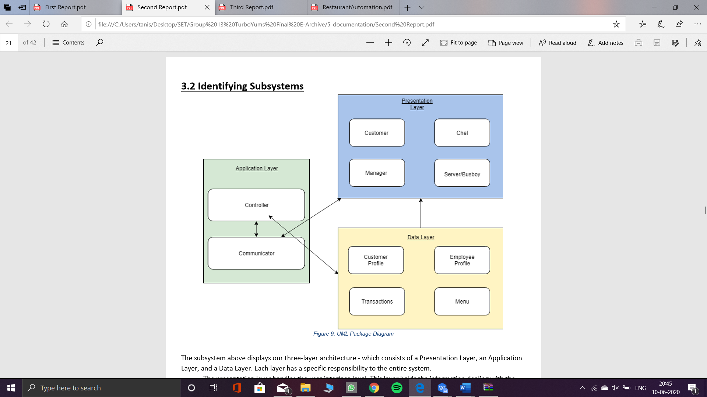
UML Diagrams
UML PACKAGE DIAGRAM

Slide 17
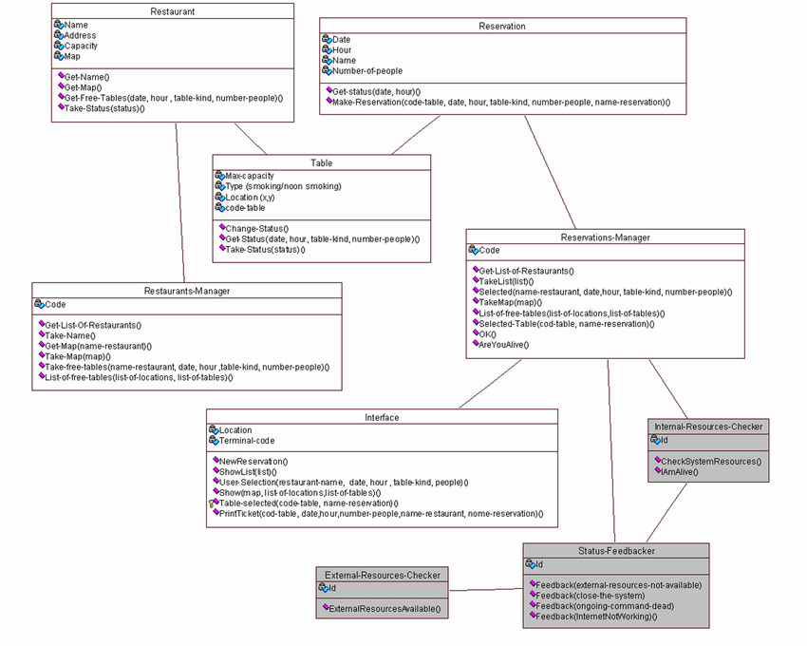
CLASS DIAGRAM

Slide 18
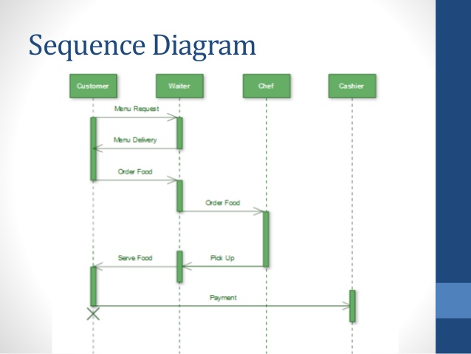
Sequence Diagram

Slide 19
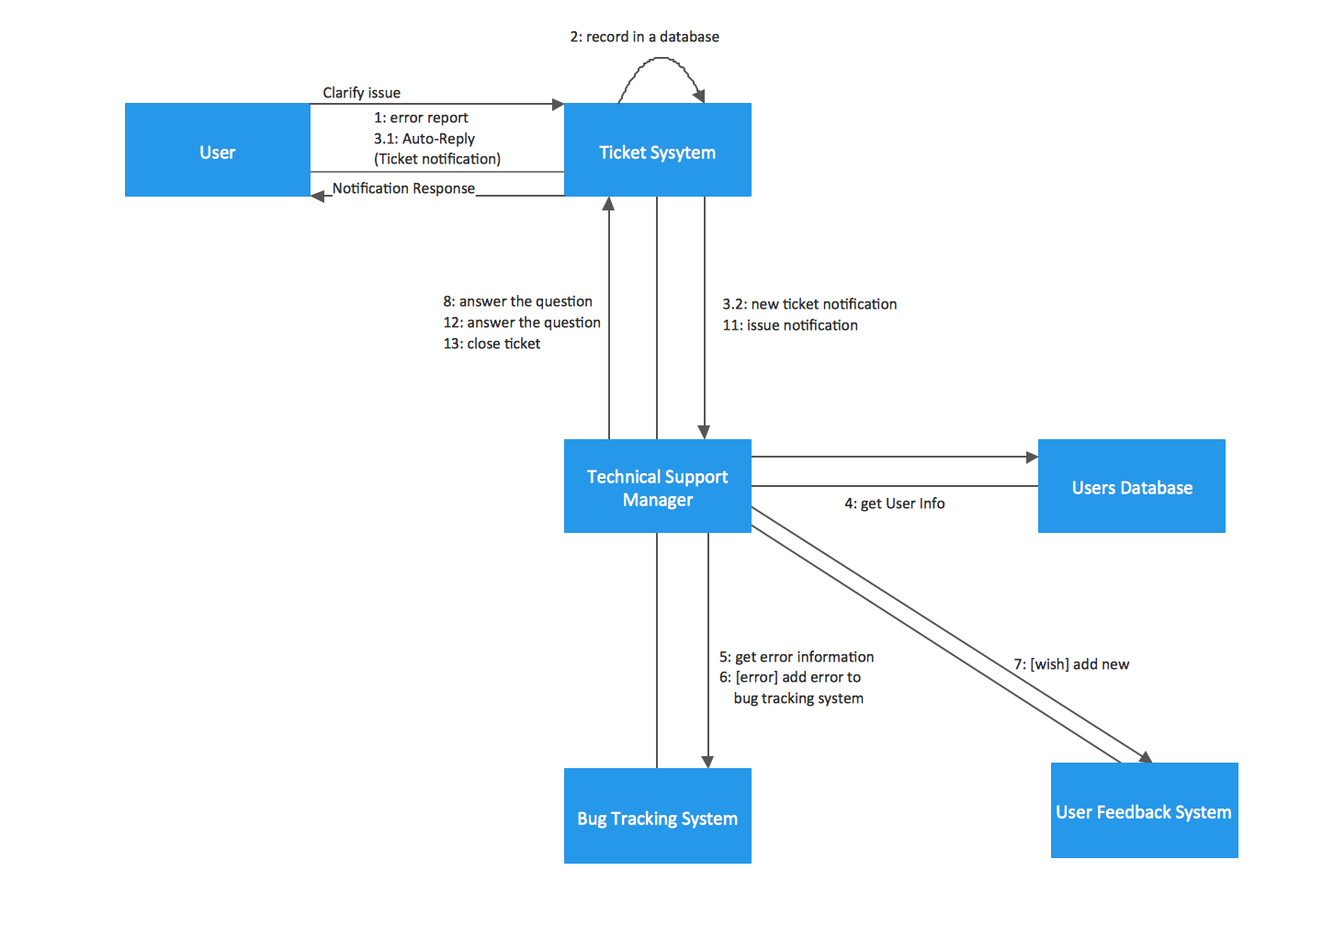
Collaboration Diagram

Slide 20
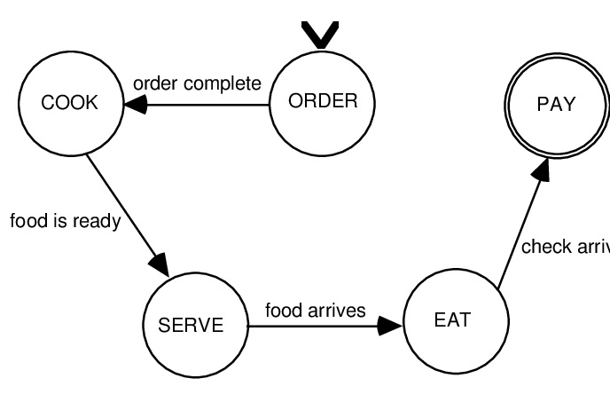
State Diagram

Slide 21
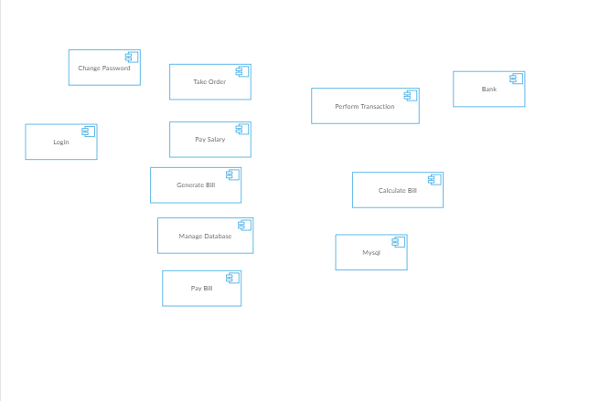
Component Diagram

Slide 22
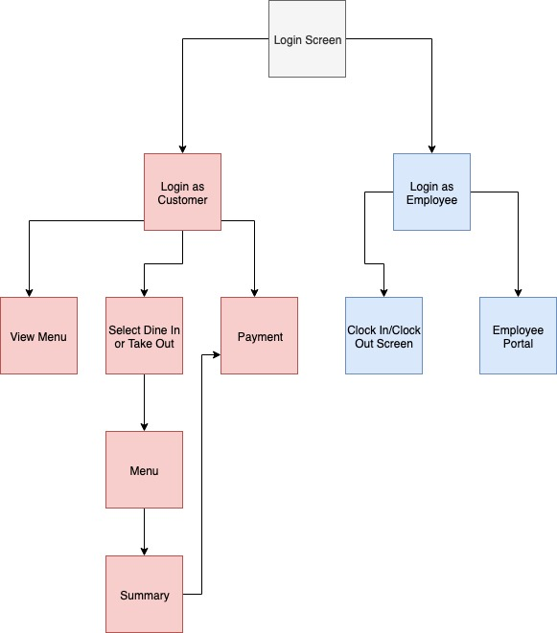
Deployment Diagram

Slide 23
CONCLUSION
Here the need for tablet food ordering is analyzed and its advantages over the traditional foodordering system in restaurants are studied. The proposed online restaurant management system istime saving and error free as compared to the traditional system. This system attracts customers and also adds the efficiency of maintaining the restaurant’s ordering and billing. Hence it is the modern way to grow up the business using Ecommerce. Here implementation of an advancedrestaurant menu ordering system using smart android mobile phone. This system entirely reducesthe unnecessary time

Slide 24
REFERENCES
Richards, Mark. “Software Architecture Patterns.” O'Reilly | Safari, O'Reilly Media, Inc., https://www.oreilly.com/library/view/software-architecture-patterns/9781491971437/ch01.html
Marsic, Ivan. “Software Engineering.” ​Professor Zoran Gajic - Home Page ​ , www.ece.rutgers.edu/~marsic/Teaching/SE/​.
Cinergix Pyt. Ltd., “Diagramming & Collaboration” https://creately.com/app/
Hanov Solutions Inc., “WebSequenceDiagrams” https://www.websequencediagrams.com/
Dimitrovski, Stephan, et al. ​Why W8 ​ . 2018, ​Why W8 ​ . https://www.ece.rutgers.edu/~marsic/books/SE/projects/Restaurant/2018f-g4-report3.pdf
El Warraky, Omar, et al. “Food•E•Z.” ​Google Sites ​ , sites.google.com/site/sefoodez/home. https://hub.packtpub.com/what-is-multi-layered-software-architecture/
“Distribution Dashboard | Android Developers.” Android Developers, developer.android.com/about/dashboards. https://developer.android.com/about/dashboards
“IOS.” Wikipedia, Wikimedia Foundation, 5 Mar. 2019, en.wikipedia.org/wiki/IOS. https://en.wikipedia.org/wiki/IOS

